Slide 1



Predicting Insurance Drug Spending

Slide 2


OUTLINE
Introduction
Problem statement
Dataset selection and Business Understanding
CRISP-DM
All about Models- Implementation, Evaluation & Comparison
Final model
Conclusion
Citations & References

Slide 3
Introduction
Accurate prediction of Insurance Drug Spending is essential for budget planning, reimbursement decisions, and policy-making in healthcare.
This project analyzes Medicare Part D claims data (2018–2022) using machine learning to forecast average drug spending per dosage unit.
Problem Statement
To develop a predictive model that can estimate future drug cost behavior, detect cost outliers, and help healthcare stakeholders make data-driven decisions.
We aim to use machine learning to automate analysis traditionally done manually, improving speed and accuracy.

Slide 4
Business Importance
Helps insurers and healthcare systems control rising drug costs
Supports decision-making in benefit design, price negotiations, and reimbursement planning
Enables identification of high-cost outlier drugs for closer monitoring

Slide 5
All About the Data
Source: data.gov – Medicare Part D Spending by Drug
Records: 13,889 | Features: 46
Years Covered: 2018 to 2022
Includes: Brand name, claims, spending, dosage units, outlier flags, CAGR, etc.

Slide 6
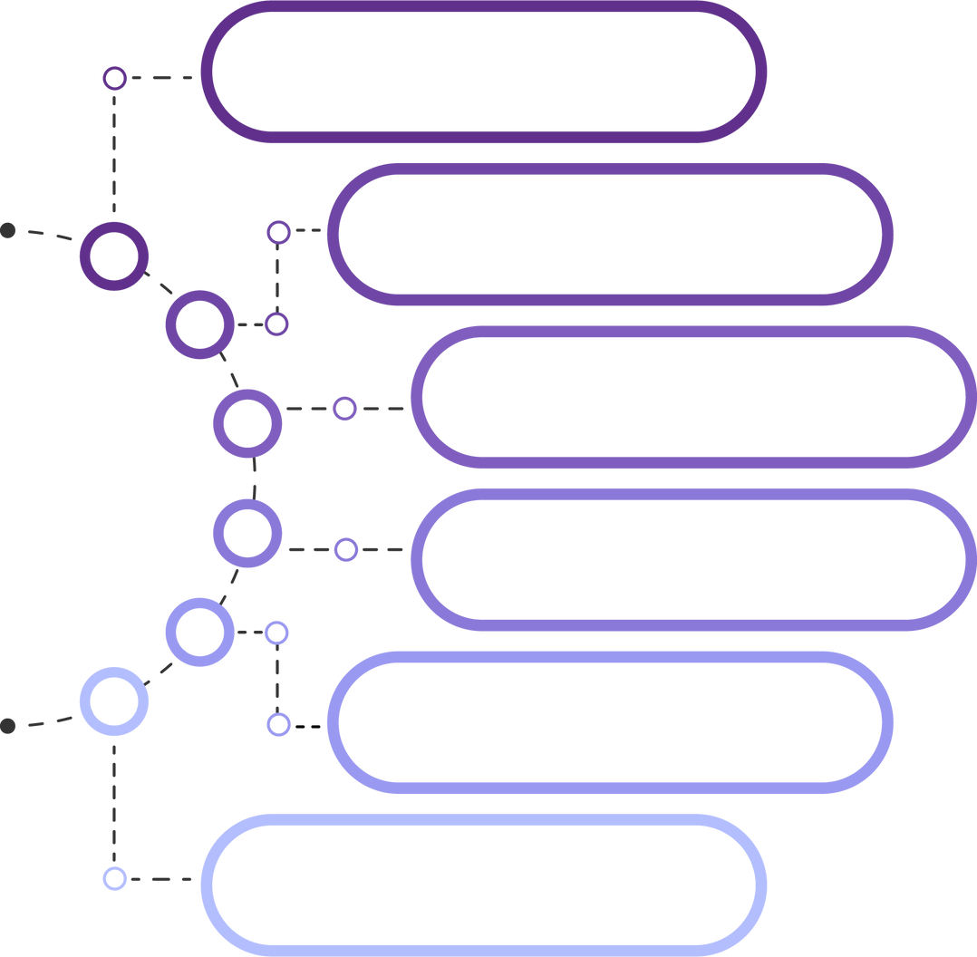

BUSINESS UNDERSTANDING
DATA PREPARATION
DATA MODELING
Crisp- DM
DATA UNDERSTANDING
EVALUATION
DEPLOYMENT

Slide 7
The rising cost of prescription drugs is a major concern for healthcare systems and insurers.
This project aims to support cost transparency and policy planning by predicting drug prices and claims using machine learning.
Key Business Goals:
Enable proactive budget planning for insurers and hospitals
Identify high-cost or anomalous drugs early for cost control
Support data-driven decisions in pricing negotiations and reimbursement policies
Help improve financial sustainability in public programs like Medicare
Business Understanding

Slide 8
Data Preparation
To prepare the dataset for modeling, the following steps were taken:
Missing Values
Dropped columns with more than 50% missing data
Removed remaining rows with any null values
Duplicate Handling
Duplicate entries were identified and removed to avoid bias
Feature Review
Categorical features (e.g., brand name) were excluded from modeling
Focused on numerical cost-related features
Outlier Awareness
Outliers were retained and later handled using log transformation, ensuring model robustness
This preparation ensured a clean and consistent dataset for accurate prediction.

Slide 9
Data Modeling
Data
Understanding
We trained and compared several machine learning models to forecast drug costs and detect outliers:
K-Nearest Neighbors Regressor (KNN) – Distance-based model; performance depends on optimal k
Random Forest Regressor – Ensemble method offering robust predictions
XGBoost – Powerful gradient boosting model
LightGBM – Fastest and most accurate model in our analysis
Linear Regressor: A simple and interpretable baseline model
Decision Tree Regressor: A tree-based model that captures non- linear relationships
We explored the structure and contents of the Medicare Part D dataset:
Dataset Shape: 13,889 rows × 46 columns
Data Types:
Numerical: Spending, dosage units, claims, beneficiaries
Categorical: Brand name, generic name, manufacturer
Target Variable:
Avg_Spnd_Per_Dsg_Unt_Wghtd_2022 (Average spending per dosage unit in 2022)
Feature Insights:
Strong year-to-year correlation among cost metrics
Categorical fields were excluded from modeling
Understanding these patterns helped in selecting relevant features for accurate predictions.

Slide 10
Evaluation
Deployment
We evaluated the models using standard performance metrics:
Evaluation Metrics:
R² Score (Coefficient of Determination) – Measures how well the predictions approximate actual values
Mean Absolute Error (MAE) – Average of absolute differences between predicted and actual values; easy to interpret
Root Mean Squared Error (RMSE) – Penalizes larger errors more than MAE; useful for understanding prediction variability
Model Insights:
LightGBM had the best balance of precision, recall, and accuracy
XGBoost was a strong alternative, especially for detecting cost anomalies
Simpler models like Logistic Regression performed moderately but lacked robustness
Goal: Make the model usable in real-world decision-making systems for healthcare cost forecasting.
Deployment Strategy:
Model will be deployed via a web-based interface
Healthcare analysts can input new drug claim data and get predicted cost per dosage unit
Backend powered by the trained LightGBM model
Benefits:
Enables real-time analysis of new drugs
Supports policy planning, pricing audits, and budget forecasting
Scalable for integration into insurance and public health platforms

Slide 11

MODELS

Slide 12
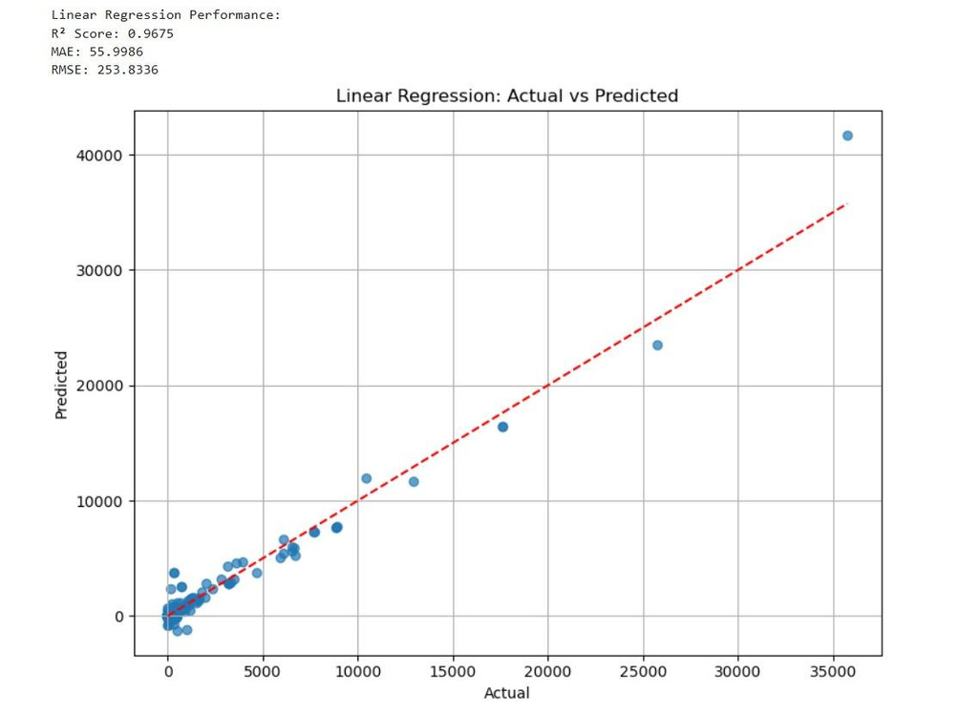
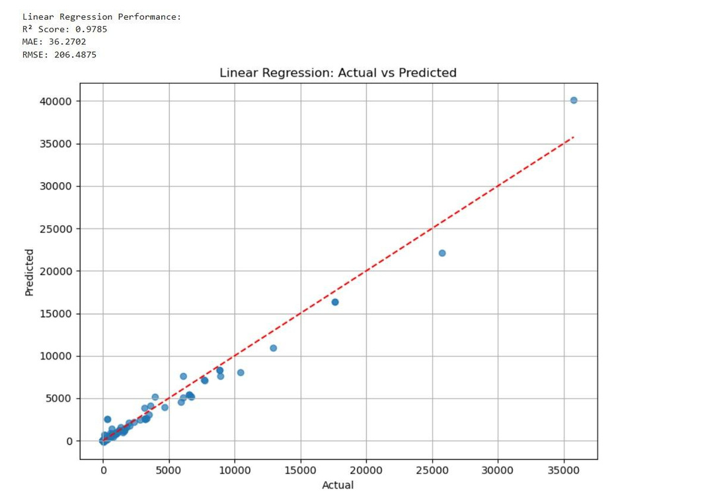
Linear Regression
Before Tuning
After Tuning
Notes:
trained a Linear Regression model using features selected based on correlation with the target variable. Initially, we used the top 8 correlated features, which gave us decent performance. Then, we retrained the model using only the top 4 features, which improved the evaluation metrics (e.g., lower RMSE, higher R²).
This change helped the model by reducing noise and multicollinearity, making it simpler and more focused on the most predictive inputs.

Slide 13
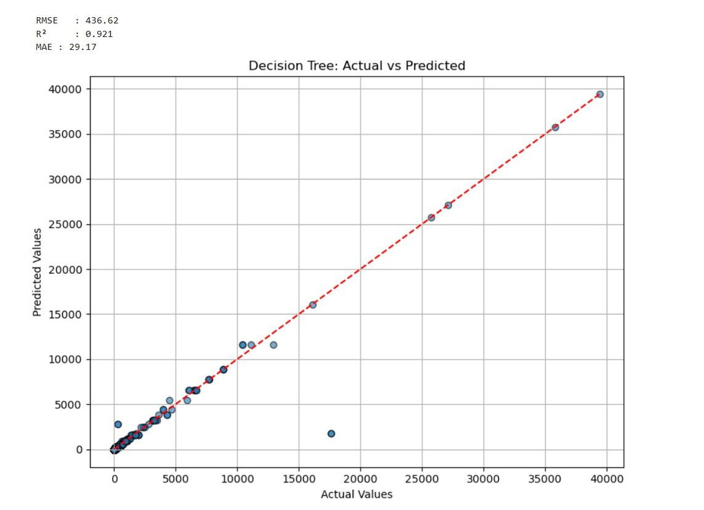
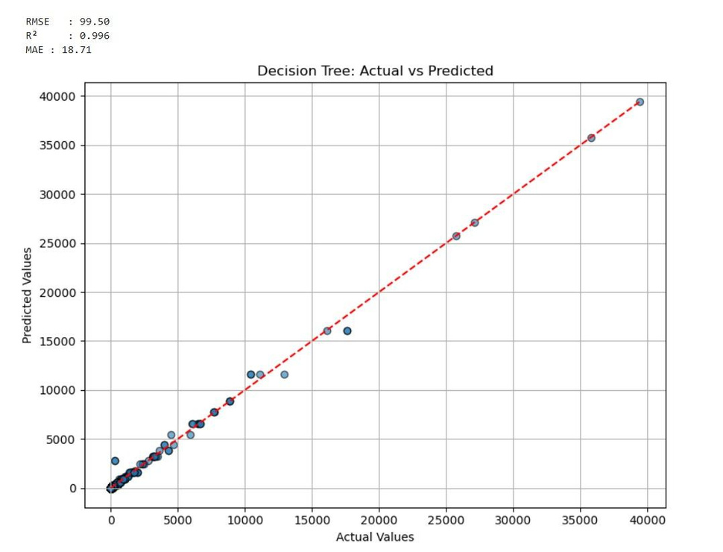
Decision Tree Regressor
Before Tuning
After Tuning
Notes:
built a Decision Tree Regressor using features selected by their correlation with the target. In the first run, we used the top 8 correlated features, and in the second, we reduced it to the top 4.
Using fewer, more relevant features improved the model's performance by reducing overfitting and making the tree structure simpler and more generalizable. This led to better evaluation scores, showing that a more focused feature set can boost model effectiveness.

Slide 14
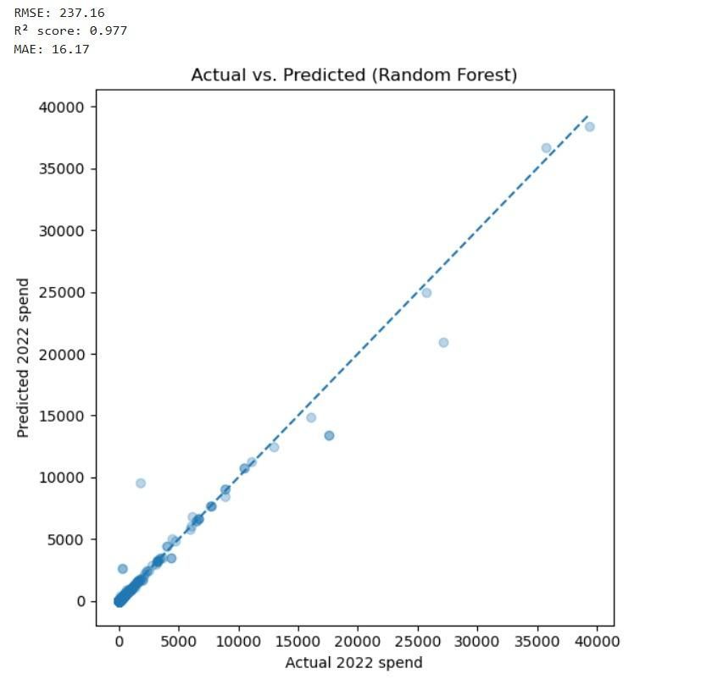
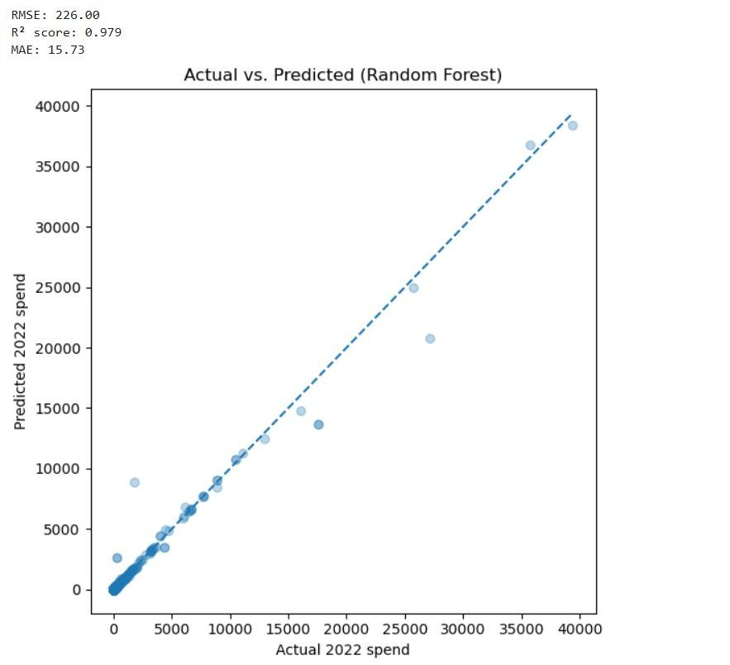
Random Forest Regressor
Before Tuning
After Tuning
Notes:
experimented with different values for the n_estimators parameter, which controls the number of decision trees in the Random Forest. Starting from 150, we tested multiple values and observed how they affected model performance.
Eventually, setting n_estimators to 250 gave us the best results in terms of accuracy and error metrics. Increasing the number of trees improved stability and reduced variance, helping the model generalize better.

Slide 15
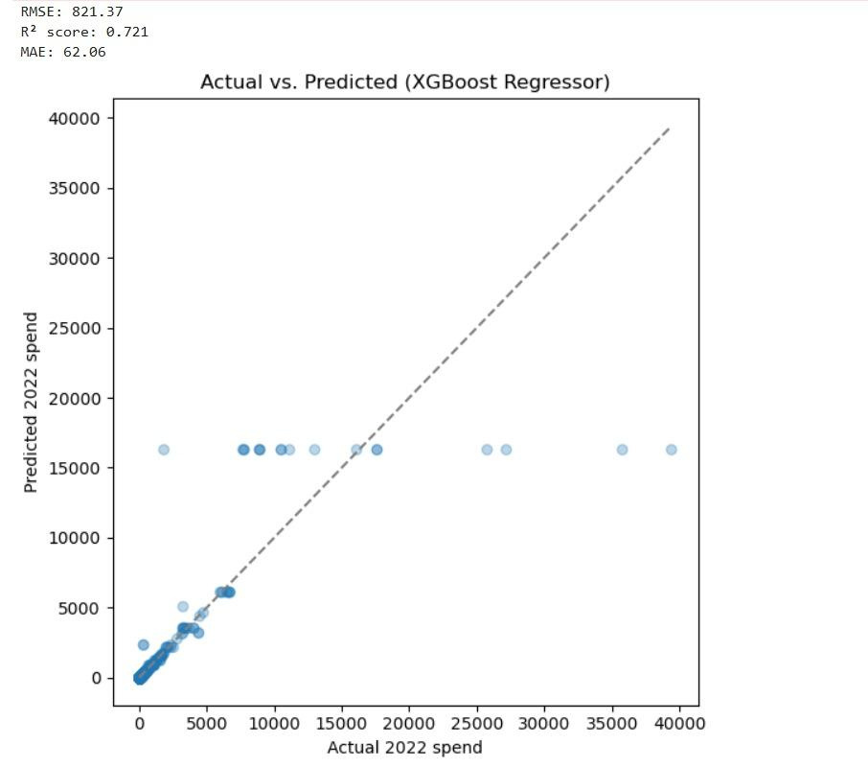
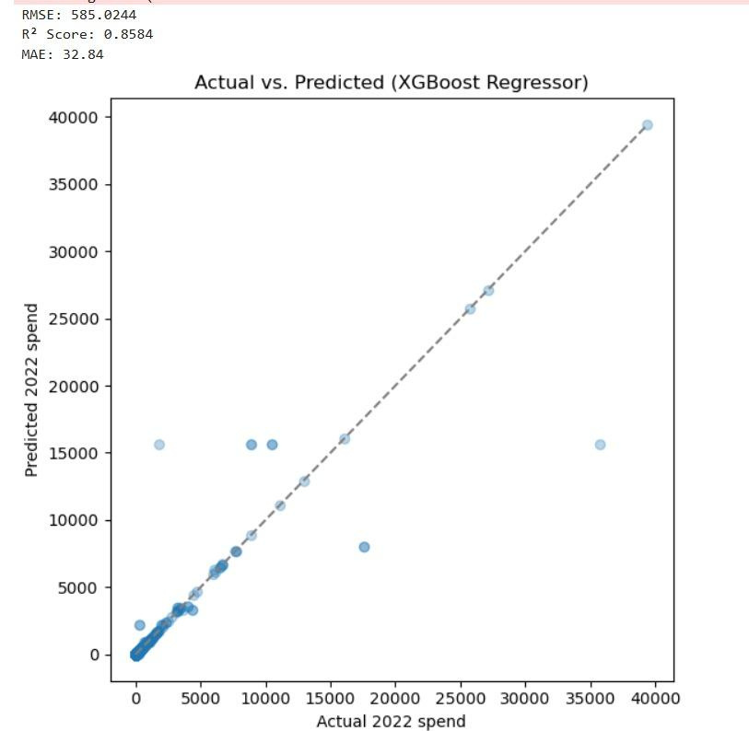
XG Boost
Before Tuning
After Tuning
Notes:
n_estimators=150, learning_rate=0.1 n_estimators=650, learning_rate=0.3
n_estimators defines the number of boosting rounds (trees). More trees can capture more complex patterns.
learning_rate controls how much each tree contributes to the final prediction. A higher rate (0.3) helps the model learn faster.

Slide 16
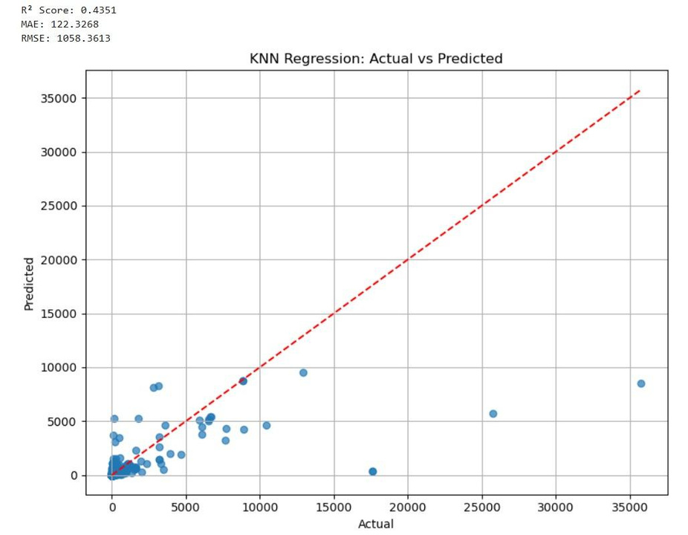
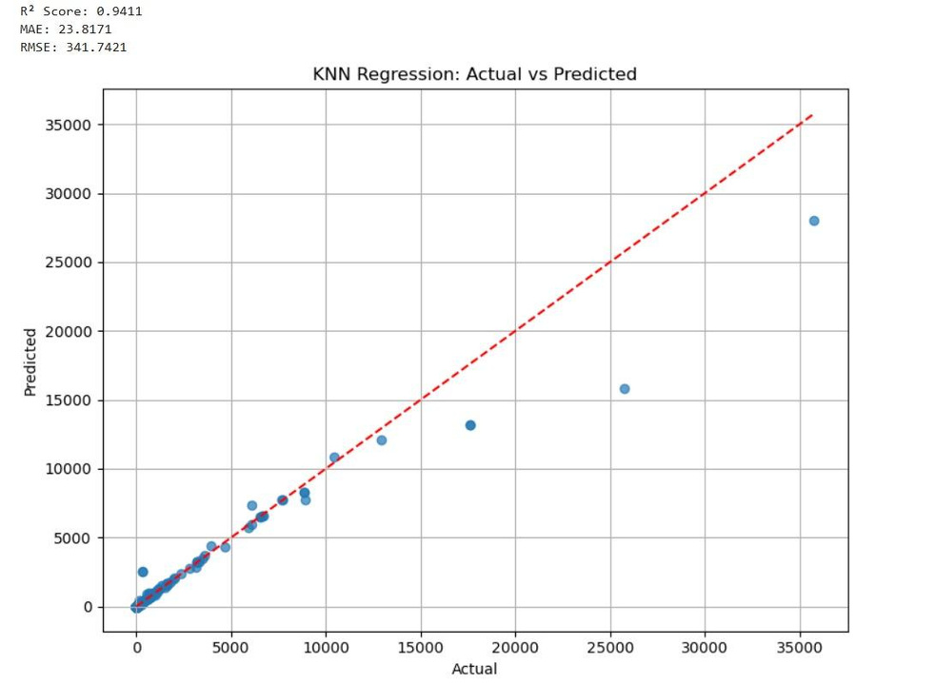
K-NN Regressor
Before Tuning
After Tuning
Notes:
Changed top 8 to top 4

Slide 17
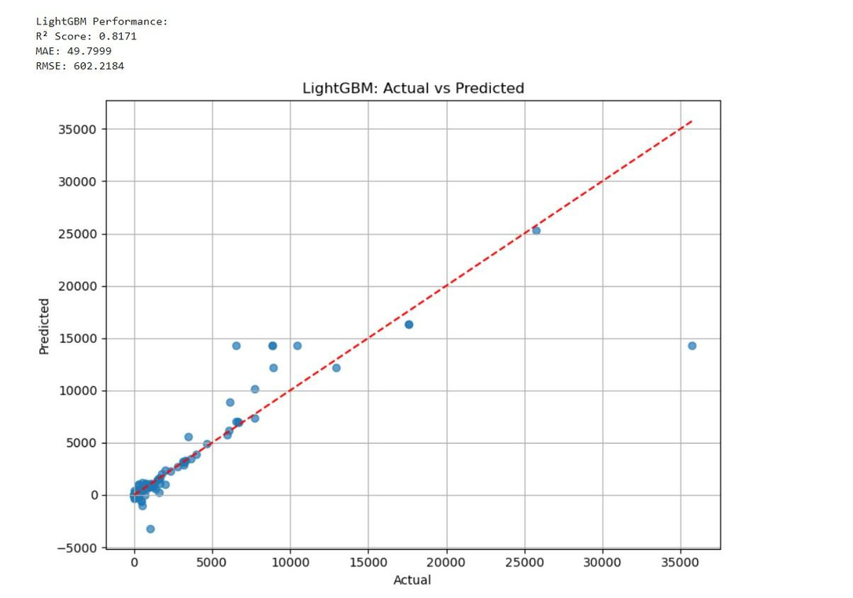
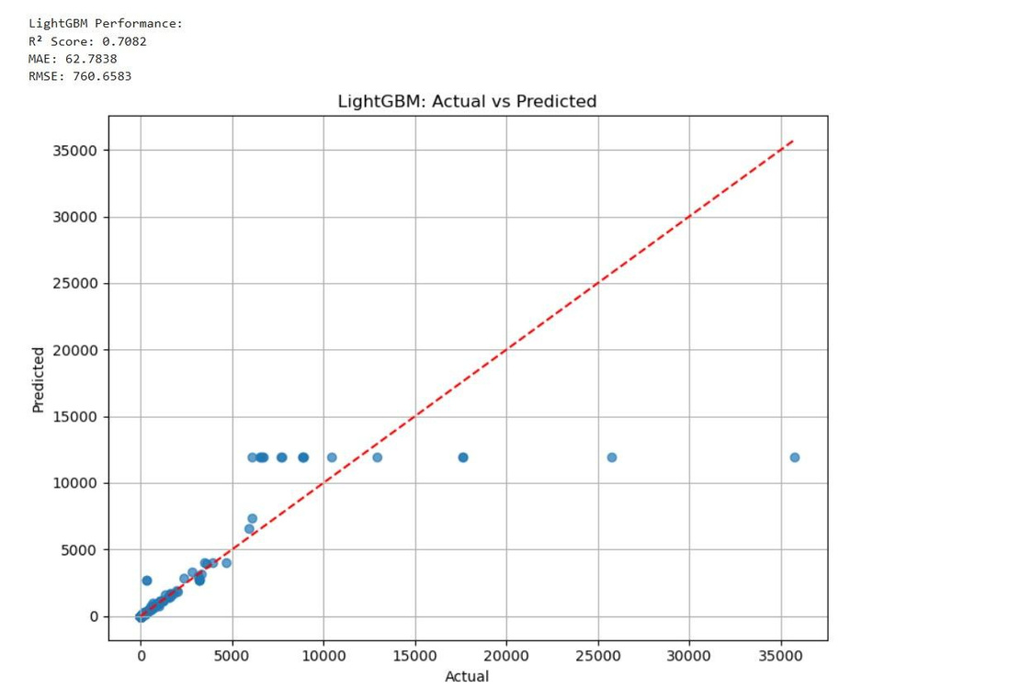
Light GBM
Before Tuning
After Tuning
Notes:
N estimator 1500
N estimator 1000 also tried changing features

Slide 18
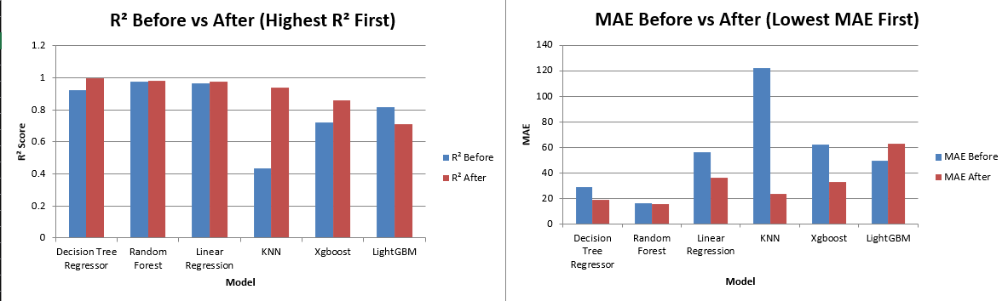
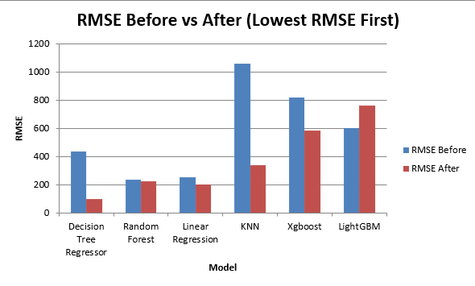
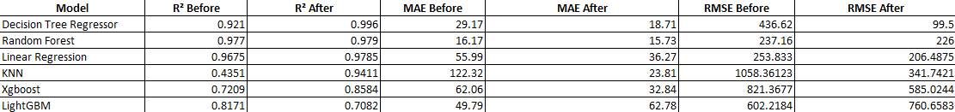
Comparison of models
Notes:
“This slide summarizes the performance of all our machine learning models, both before and after tuning.
Starting with the R² chart, I can see that Decision Tree Regressor achieved the highest R² after tuning, followed closely by Random Forest and Linear Regression, indicating strong predictive power.
In terms of MAE and RMSE, which represent the error margins, Decision Tree again had the lowest post-tuning RMSE at around 99, while Random Forest also showed competitive error values, confirming their stability.
Interestingly, while LightGBM is powerful in general, in our case, they performed better before tuning, so I chose to retain the original versions.
Overall, this comparison helped us conclude that Decision Tree and Random Forest are our most reliable models for predicting 2022 drug spending per dosage unit.”

Slide 19
Thank you!

